Slide 2
The
1 | 0 | 0 | 0 | 0
cat
0 | 1 | 0 | 0 | 0
sat
0 | 0 | 1 | 0 | 0
on
0 | 0 | 0 | 1 | 0
mat
0 | 0 | 0 | 0 | 1

Slide 3
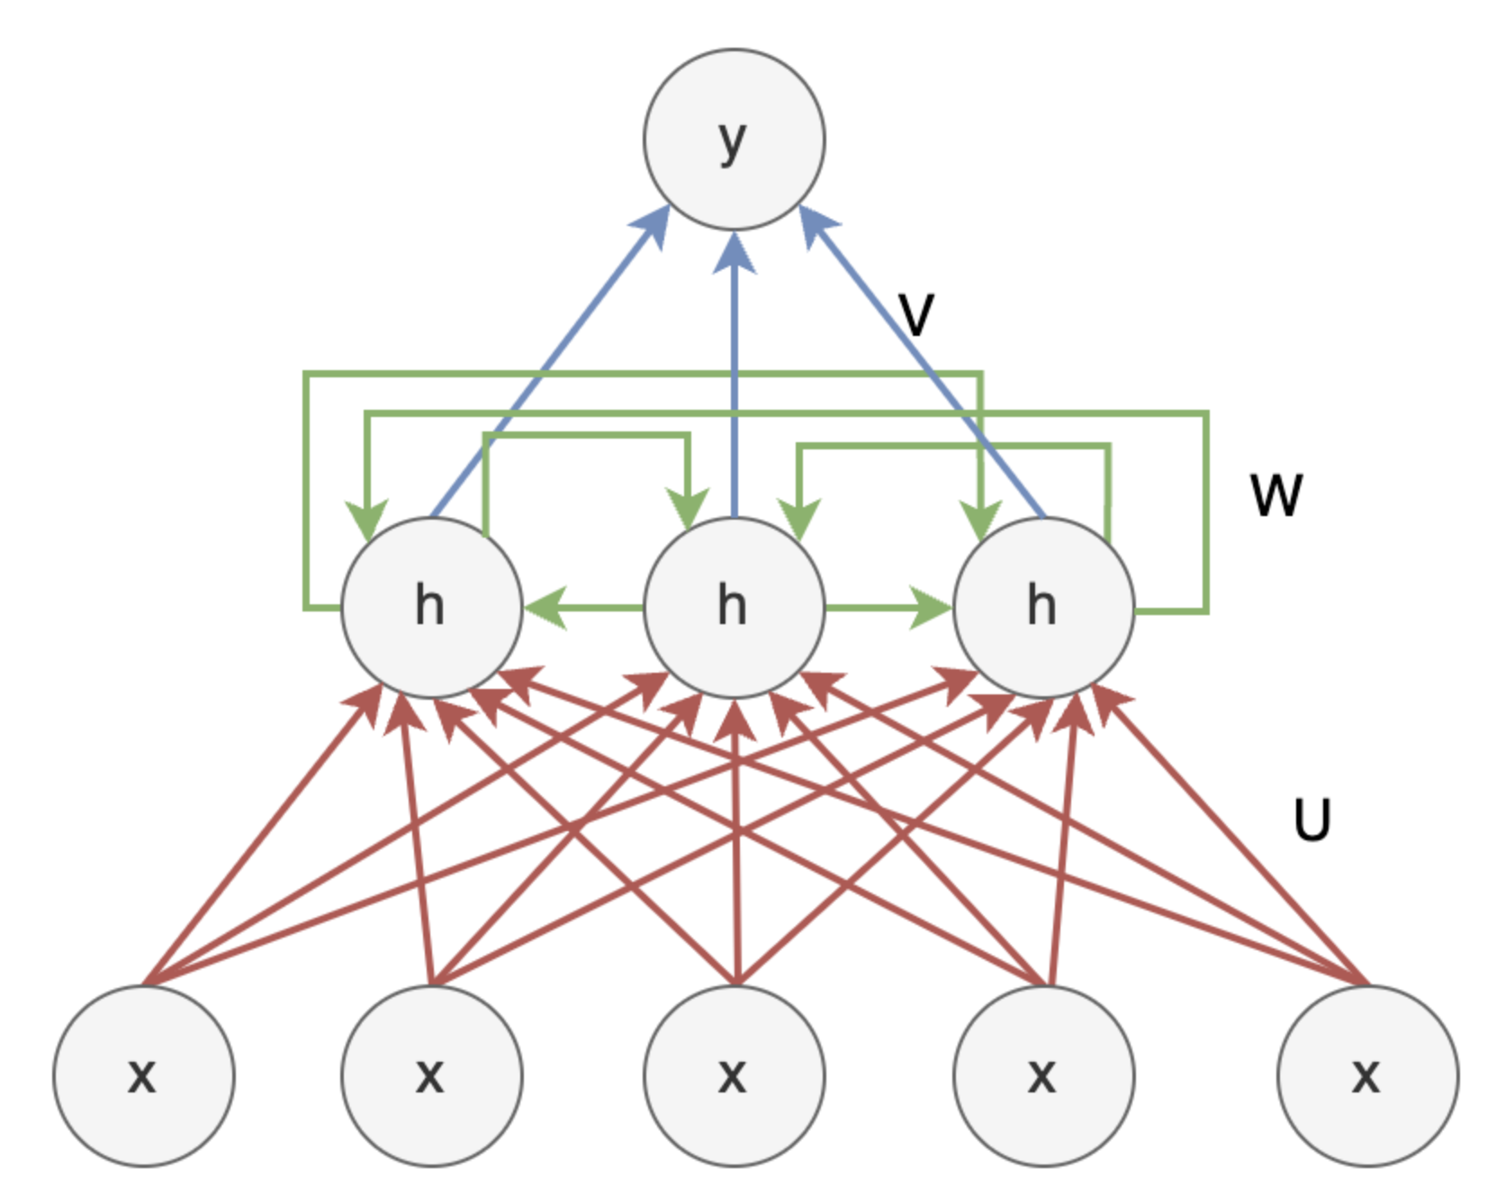

Slide 4
y₁
U * x₁ = [
[0.8, 0.2, 0.1, 0.5, 0.3]
[0.3, 0.7, 0.9, 0.2, 0.4]
[0.5, 0.4, 0.6, 0.1, 0.8]
]
0.212 | 0.168 | 0.194 | 0.223 | 0.203
* [1, 0, 0, 0, 0]ᵀ = [0.8, 0.3, 0.5]
0.9 | 0.1 | 0.1
0.2 | 0.8 | 0.1
0.1 | 0.3 | 0.7
0.4 | 0.3 | 0.6
0.2 | 0.6 | 0.5
W * h₀ = [
[0.5, 0.6, 0.4]
[0.1, 0.8, 0.2]
[0.7, 0.2, 0.9]
]
V =
* [0.0, 0.0, 0.0]ᵀ = [0.0, 0.0, 0.0]
(d * h)
h₁ = tanh(U * x₁ + W * h₀ + b)
0.5 | 0.6 | 0.4
0.1 | 0.8 | 0.2
0.7 | 0.2 | 0.9
h₁ = [0.8, 0.3, 0.5] + [0.0, 0.0, 0.0] + [0.1, 0.2, 0.3]
= [0.9, 0.5, 0.8]
0.0 | 0.0 | 0.0
W =
0.7 | 0.37 | 0.66
h₀
h₁
h₁ = tanh([0.9, 0.4, 0.8]) = [0.7, 0.37, 0.66]
(h * h)
y₁ = softmax(V * h₁)
[
[0.9, 0.1, 0.1],
[0.2, 0.8, 0.1],
[0.1, 0.3, 0.7],
[0.4, 0.3, 0.6],
[0.2, 0.6, 0.5]
]
0.8 | 0.2 | 0.1 | 0.5 | 0.3
0.3 | 0.7 | 0.9 | 0.2 | 0.4
0.5 | 0.4 | 0.6 | 0.1 | 0.8
y₁=
U =
* [0.7, 0.37, 0.66]ᵀ
“The cat sat on mat”
d (dimension – size of the vocabulary) = 5
(h * d)
softmax([0.733, 0.502, 0.643, 0.787, 0.692])
h (hidden units) = 3
y₁ =
1 | 0 | 0 | 0 | 0
bias =
0.1 | 0.2 | 0.3
[0.212, 0.168, 0.194, 0.223, 0.203]
y₁ =
x₁

Slide 5
y₂
U * x₂ = [
[0.8, 0.2, 0.1, 0.5, 0.3]
[0.3, 0.7, 0.9, 0.2, 0.4]
[0.5, 0.4, 0.6, 0.1, 0.8]
]
0.17 | 0.18 | 0.19 | 0.22 | 0.24
* [0, 1, 0, 0, 0]ᵀ = [0.2, 0.7, 0.4]
0.9 | 0.1 | 0.1
0.2 | 0.8 | 0.1
0.1 | 0.3 | 0.7
0.4 | 0.3 | 0.6
0.2 | 0.6 | 0.5
W * h₁ = [
[0.5, 0.6, 0.4]
[0.1, 0.8, 0.2]
[0.7, 0.2, 0.9]
]
V =
* [0.7, 0.37, 0.66]ᵀ = [0.836, 0.498, 1.158]
(d * h)
h₂ = tanh(U * x₂ + W * h₁ + b)
0.5 | 0.6 | 0.4
0.1 | 0.8 | 0.2
0.7 | 0.2 | 0.9
h₂ = [0.2, 0.7, 0.4] + [0.836, 0.498, 1.158] + [0.1, 0.2, 0.3]
= [1.136, 1.398, 1.858]
0.7 | 0.37 | 0.66
W =
0.82 | 0.88 | 0.95
h₁
h₂
h₂ = tanh ([1.136, 1.398, 1.858]) = [0.82, 0.88, 0.95]
(h * h)
y₂ = softmax(V * h₂)
[
[0.9, 0.1, 0.1],
[0.2, 0.8, 0.1],
[0.1, 0.3, 0.7],
[0.4, 0.3, 0.6],
[0.2, 0.6, 0.5]
]
0.8 | 0.2 | 0.1 | 0.5 | 0.3
0.3 | 0.7 | 0.9 | 0.2 | 0.4
0.5 | 0.4 | 0.6 | 0.1 | 0.8
y₂=
U =
* [0.82, 0.88, 0.95]ᵀ
“The cat sat on mat”
d (dimension – size of the vocabulary) = 5
(h * d)
softmax([0.921, 0.963, 1.011, 1.162, 1.167])
h (hidden units) = 3
y₂ =
0 | 1 | 0 | 0 | 0
bias =
0.1 | 0.2 | 0.3
[0.17, 0.18, 0.19, 0.22, 0.24]
y₂ =
x₂

Slide 6

Compute total loss
Step 1 - Calculate the cross-entropy loss for each time step.
For each time step t, the cross-entropy loss L_{t}​ is calculated using the formula:
where i indexes over the vocabulary.
Given our predicted probabilities
y₁ =[0.212,0.168,0.194,0.223,0.203] and
y₂​=[0.17,0.18,0.19,0.22,0.24], and the actual targets
actual_y1​=[0,1,0,0,0] (for "cat") and
actual_y2​=[0,0,1,0,0] (for "sat"), we can calculate the loss for each time step:​
L₁​=−log(0.168)
L₂​=−log(0.19)

Slide 7
Compute total loss
Step 2 - Sum the losses across all time steps to get the total loss
The total loss for the sequence is the sum of the individual losses:
L=L₁​+L₂​=−log(0.168)−log(0.19)
L₁​≈−log(0.168)≈1.783
L₂​≈−log(0.19)≈1.661
Therefore, the total loss for the sequence "The cat sat" is approximately:
L≈1.783+1.661=3.444
This total loss gives us a measure of how well our RNN predicted the next words in the sequence at these two-time steps. The goal during training is to minimize this loss by adjusting the weights of the network.

Slide 8
Backpropagation for Output Layer Weights (V)
Calculate the gradient of the loss with respect to the output probabilities (δt​) at each time step
δ₁​=y₁​−actual_y₁​=[0.212,−0.832,0.194,0.223,0.203]
δ₂​=y₂​−actual_y₂​=[0.17,0.18,−0.81,0.22,0.24]
Calculate the gradient of the loss with respect to V (∇_{V​}L) by taking the product of δt​ and the corresponding hidden state h_{t}^{T}​ at each time step and summing across time steps.
Assuming we have the hidden states h₁​ and h₂​ for the corresponding time steps (let's say h₁​=[0.7,0.37,0.66] and h₂​=[0.8,0.5,0.7]), we would calculate:
∇_{V}​L₁​=δ₁​×h₁^{T}​
∇_{V}​L₂​=δ₂​×h₂^{T​}

Slide 9
Backpropagation for Output Layer Weights (V)
The total gradient for V would be the sum of these individual gradients:
∇_{V}​L=∇_{V}​L₁​+∇_{V}​L_{2​}
This part involves calculating the gradients for the output layer weights based on the errors at the output and the hidden states.

Slide 10
Backpropagation for Hidden Layer Weights (U and W)
This step involves backpropagating the error from the output layer through the network to the hidden layers.
The gradient of the loss with respect to the hidden state at the last time step (h₃​ in our case) is influenced directly by the gradient at the output layer (δ₃​).
For previous time steps (h₂​, h₁​), this gradient also includes contributions propagated back from future time steps. This is where the Backpropagation Through Time (BPTT) comes into play, as we need to consider the impact of each hidden state on all subsequent time steps.

Slide 11
Backpropagation for Hidden Layer Weights (U and W)
Calculate the gradients for W and U using the gradients with respect to the hidden states.
The gradient of the loss with respect to W at each time step involves the gradient with respect to the current hidden state and the previous hidden state.
For example, for time step 2, it would involve ∂L/∂h₂​ and h₁​.
The gradient of the loss with respect to U at each time step involves the gradient with respect to the current hidden state and the input at that time step.
For example, for time step 2, it would involve ∂L/∂h₂​​ and x₂​.

Slide 12
Backpropagation for Hidden Layer Weights (U and W)
Sum the gradients across all time steps for W and U.
Since W and U are used at each time step, their gradients from each time step are summed to get the total gradient for each weight matrix. This is the accumulated gradient that we use to update the weights.

Slide 13


Backpropagation for Hidden Layer Weights (U and W)
Let's assume we have calculated ​∂L/ ∂h₂ ​ and ​∂L/ ∂h₁ ​ (the gradients of the loss with respect to the hidden states at time steps 2 and 1, respectively) through BPTT. Then:
The gradient for W at time step 2 is calculated as:
The gradient for U at time step 2 is calculated as
The total gradients for W and U would then be the sum of their respective gradients across all time steps.

Slide 14



Backpropagation for Hidden Layer Weights (U and W)
Update Weights
In this step, we use the gradients we calculated in previous step to update the weights of the network. This is done using the gradient descent algorithm, where we subtract a fraction of the gradient from the current weights. The size of this fraction is determined by the learning rate (η), which controls how big of a step we take in the direction opposite to the gradient.
The weight update equations are as follows:
Update the output layer weights (V):
Update the hidden-to-hidden weights (W):
Update the input-to-hidden weights (U):

Slide 15
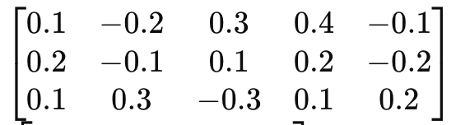
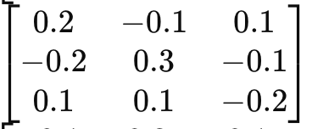
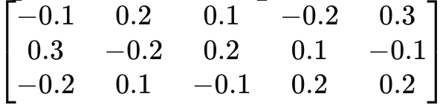
Example Calculation:
Let's assume we have the following gradients are:
∇V​L =
∇W​L =
∇U​L = ​

Slide 16
Example Calculation:
And let's assume a learning rate (η) of 0.01. Then the weight updates would be:
V=V−0.01×∇_{V}​L
W=W−0.01×∇_{W}​L
U=U−0.01×∇_{U}​L
This step completes one iteration of the backpropagation process. In practice, this process is repeated for many iterations (or epochs) over the training data until the network's performance converges to a satisfactory level.

Slide 17
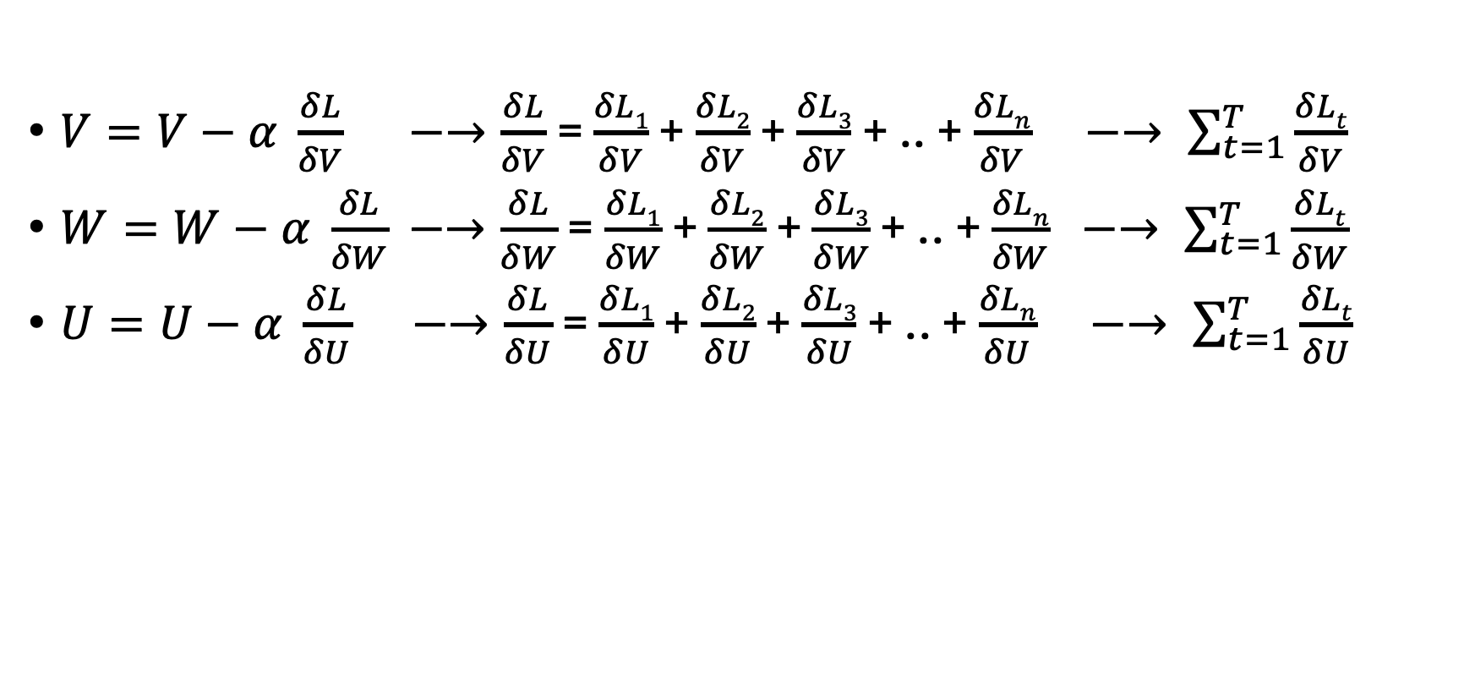
Back Propagation through time:
$V=V−α \frac{δL}{δV} −→\frac{δL}{δV}$ = $\frac{δL1}{δV}$ + $\frac{δL2}{δV}$ + $\frac{δL3}{δV}$ + .. + $\frac{δLn}{δV} −→ \sum_{t=1}^{T}{\frac{δLt}{δV}}$
$W=W−α \frac{δL}{δW}$ $−→\frac{δL}{δW}$ = $\frac{δL1}{δW}$ + $\frac{δL2}{δW}$ + $\frac{δL3}{δW}$ + .. + $\frac{δLn}{δW} −→ \sum_{t=1}^{T}{\frac{δLt}{δW}}$
$U=U−α \frac{δL}{δU}$ $−→\frac{δL}{δU}$ = $\frac{δL1}{δU}$ + $\frac{δL2}{δU}$ + $\frac{δL3}{δU}$ + .. + $\frac{δLn}{δU} −→ \sum_{t=1}^{T}{\frac{δLt}{δU}}$

Slide 18
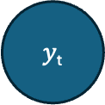
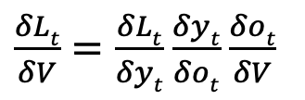
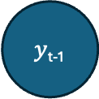
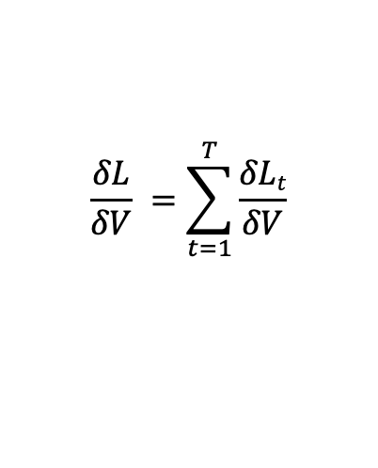
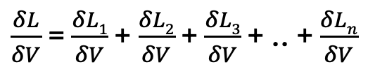
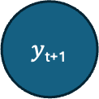
y_{t-1}
y_{t}
y_{t+1}
$\frac{δL}{δV}$ = $\frac{δL1}{δV}$ + $\frac{δL2}{δV}$ + $\frac{δL3}{δV}$ + .. + $\frac{δLn}{δV}$
L_{t-1}
L_{t}
L_{t+1}
$$\frac{δL}{δV} =\sum_{t=1}^{T}{\frac{δLt}{δV}}$$
$y$_{t-1}
$y$_{t}
$y$_{t+1}
$\frac{δLt}{δV}=\frac{δLt}{δyt}$ $\frac{δyt}{δot}$ $\frac{δot}{δV}$
o_{t-1}
o_{t}
o_{t+1}
[0.212, 0.168, 0.194, 0.223, 0.203]
V
V
V
h_{(…)}
h_{t-1}
h_{t}
h_{t+1}
h_{(…)}
W
W
W
W
U
U
U
x_{t-1}
x_{t}
x_{t+1}

Slide 19
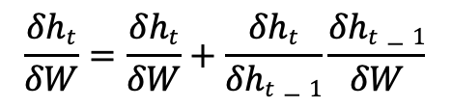
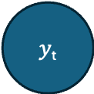
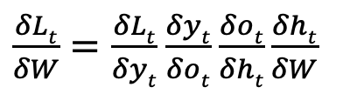
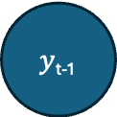
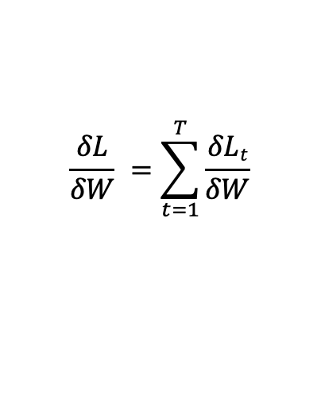
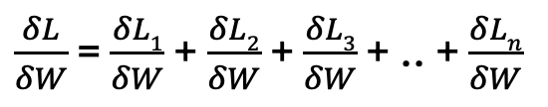
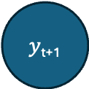
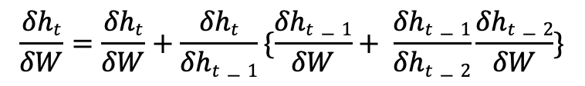
y_{t-1}
y_{t}
y_{t+1}
$\frac{δL}{δW}$ = $\frac{δL1}{δW}$ + $\frac{δL2}{δW}$ + $\frac{δL3}{δW}$ + .. + $\frac{δLn}{δW}$
L_{t-1}
L_{t}
L_{t+1}
$$\frac{δL}{δW} =\sum_{t=1}^{T}{\frac{δLt}{δW}}$$
$y$_{t-1}
$y$_{t}
$y$_{t+1}
$\frac{δLt}{δW}=\frac{δLt}{δyt}$ $\frac{δyt}{δot}$ $\frac{δot}{δht}\frac{δht}{δW}$
o_{t-1}
o_{t}
o_{t+1}
$$\frac{δht}{δW}=\frac{δht}{δW}+\frac{δht}{δht−1}\frac{δht−1}{δW}$$
V
V
V
$$\frac{δht}{δW}=\frac{δht}{δW}+\frac{δht}{δht−1}\{\frac{δht−1}{δW}+ \frac{δht−1}{δht−2}\frac{δht−2}{δW}\}$$
h_{(…)}
h_{t-1}
h_{t}
h_{t+1}
h_{(…)}
W
W
W
W
U
U
U
x_{t-1}
x_{t}
x_{t+1}

Slide 20
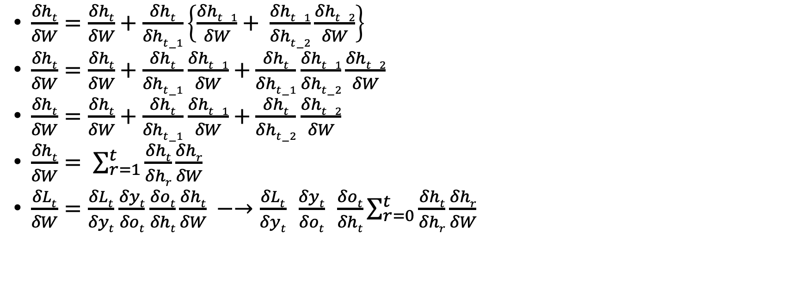
$\frac{δht}{δW}=\frac{δht}{δW}+\frac{δht}{δht−1}\left\{\frac{δht−1}{δW}+ \frac{δht−1}{δht−2}\frac{δht−2}{δW}\right\}$
$\frac{δht}{δW}=\frac{δht}{δW}+\frac{δht}{δht−1}$ $\frac{δht−1}{δW}+$ $\frac{δht}{δht−1}$ $\frac{δht−1}{δht−2}\frac{δht−2}{δW}$
$\frac{δht}{δW}=\frac{δht}{δW}+\frac{δht}{δht−1}$ $\frac{δht−1}{δW}+$ $\frac{δht}{δht−2}$ $\frac{δht−2}{δW}$
$\frac{δht}{δW}= \sum_{r=1}^{t}{\frac{δht}{δhr}\frac{δhr}{δW}}$
$\frac{δLt}{δW}=\frac{δLt}{δyt}$ $\frac{δyt}{δot}$ $\frac{δot}{δht}\frac{δht}{δW} −→\frac{δLt}{δyt} \frac{δyt}{δot} \frac{δot}{δht}\sum_{r=0}^{t}{\frac{δht}{δhr}\frac{δhr}{δW}}$

